Slide 1
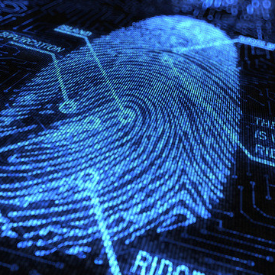
Crime to Courtroom: Digital forensics on usb device
Morgan Brown & Nayah Chiumya
This Photo by Unknown Author is licensed under CC BY-ND

Slide 2
Overview
Description
Objectives
This project is a grey box-based test on file system forensics.
1
Work with incident response and digital forensics cohesively
2
Simulate Cyberattack and report findings
> Analyzing USB malware case study
> Recovering deleted data

Slide 3
Analyzing Usb MALWARE CASE Study
Background
Honeywell Gard USB Threat Report 2024:
April 30th, 2024, Honeywell INC released a report on malware found on USB devices. In this report Honeywell’s Global Analysis, Research and Defense (GARD) team recorded the attack variations, security implications amongst operators, and targeted vectors.
Honeywell Inc. is an American multinational conglomerate corporation that specializes in solving complex challenges within aerospace, automation, energy and industrial business.

Slide 4
HONEYWELL GARD Findings
“A significant portion of blocked malware was content-based, using existing documents and scripting functions maliciously rather than attempting to exploit novel vulnerabilities.”
“Evidence continues to indicate that USB removable media is intentionally used as an initial attack vector into industrial control/OT environments.”
“Threats crossing the air gap via USB are used to establish a toe hold into industrial systems, opening backdoors and remote access to install additional payloads and remote command-and-control.”
“51% of malware attacks are designed for USB devices, according to 2024 data”

Slide 5
Case Scenario: Drug Trafficking
During the 2024-2025 school year, Gumber State University reported a total of 50 student overdoses. Of these cases, 80% of the students survived, while 20% resulted in fatalities. Forensic autopsy reports on the deceased revealed that all had died from the same substances. This discovery, coupled with a pattern of repeated 911 calls, drew the attention of the residential police department, prompting further investigation into the remaining 80% of overdose cases and potential connections between them.
Through interviews with credible witnesses and victims, police narrowed their focus to a key suspect, known by the alias “Richie Rich”. After identifying the suspect based on witness and victim descriptions of a linear rose tattoo, police arrested “Richie Rich” government Richard Wazowski and confiscated a USB drive, and 20 grams of crack.

Slide 6
Data Input Validation
Private.docx - f36a00be917d8668e29a529f718a178c1004b2cba521382a98af93881f2765a4
Sha256
RVOX9130.MOV - 9819e2d0612f9a536187571d68a7eb543fe9f9d6993c52c3be76d69fcb48cec1
Sha256
Screenshot of the email - a23ae97909f91966c6e7edc4d23f7f3c18220c7eaf25801d2be3ed0e273d05fd

Slide 7
Recovery Process
Preservation Phase
Ingestion and Indexing
File analysis

Slide 8
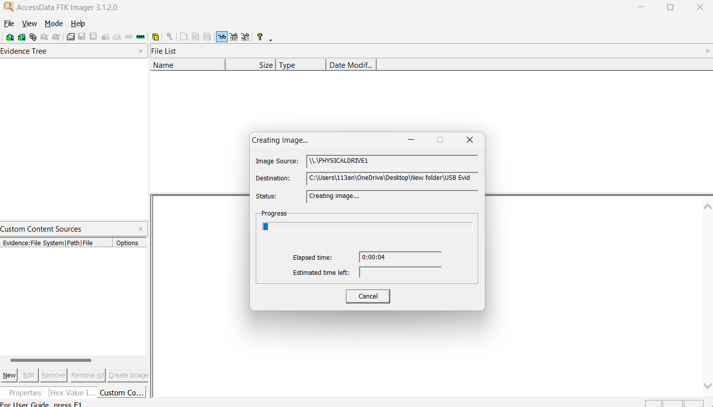
Preservation Phase
In the process of this Forensic Investigation, we made an image disk of the USB drives contents.
An image disk is a file that contains a copy the contents of a disk, such as a hard drive, optical disk, or other storage device. In this case our storage device was a USB drive.
We made a copy of the image disk through FTK Imager. Our reasoning for making an image disk of the USB drive was to protect the integrity of the data on the USB drive.
Screenshot of Creating a copy of the disk image

Slide 9
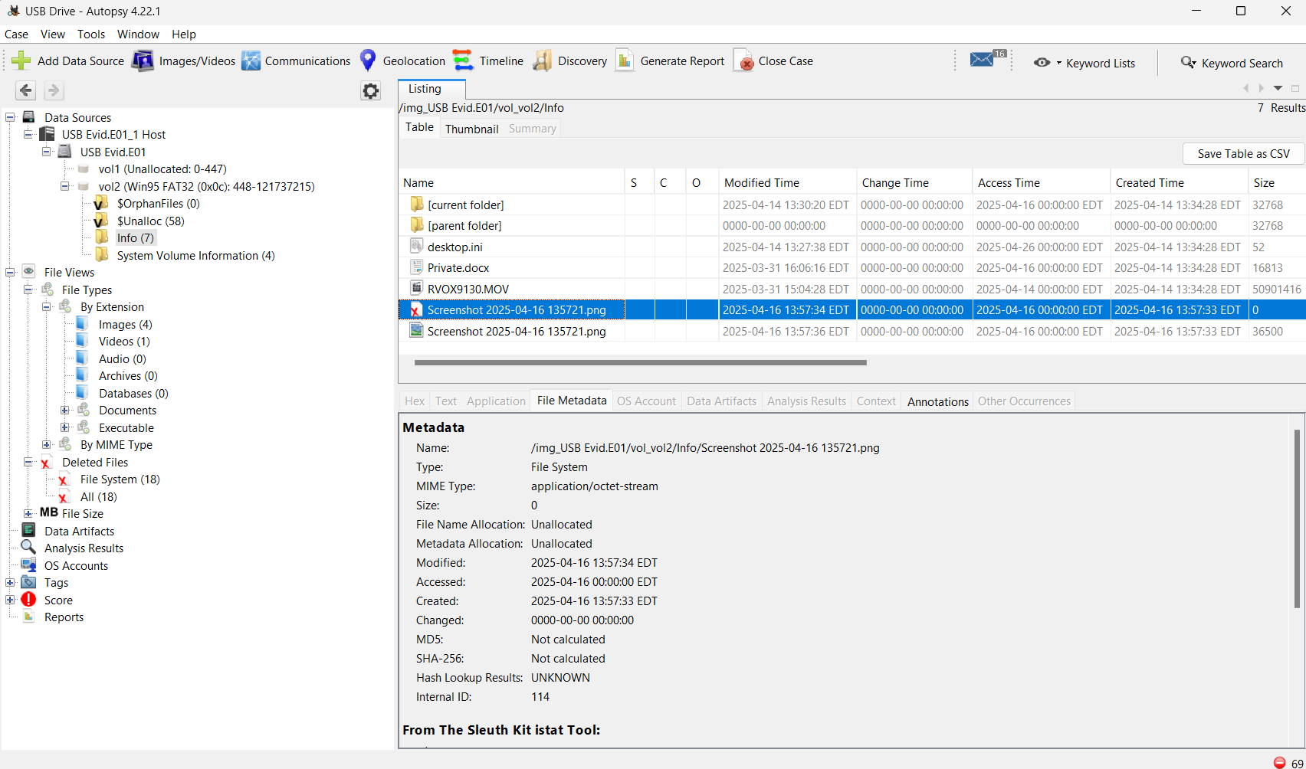
Ingestion and Indexing
Once the image disk of the USB drive was created, we loaded the image disk into Autopsy. Autopsy automatically launched various analysis modules such as the File Systems Analysis, Deleted File Recovery, and the Keyword and File Type Indexing.
The File Systems Analysis sifted through the image to reconstruct the files and the directory that was on the image.
The Deleted File Recovery identified and listed the files marked as deleted but not yet overwritten.
The Keyword and File Type Indexing allowed us to search for specific terms or file types more quickly.
List what autopsy holds
Using the Deleted Files section, we were able to locate and preview the deleted photo. Autopsy recovered the deleted photo based on metadata remnants in the file system.
While the text file was likely marked as hidden using the standard file attribute in the USB's file system, Autopsy reads file systems at a low level which allows them to bypass the hidden attribute by reading all the metadata regardless of its flag visibility.

Slide 10
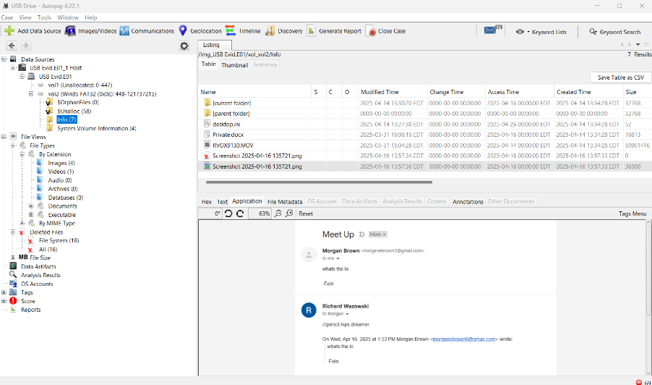
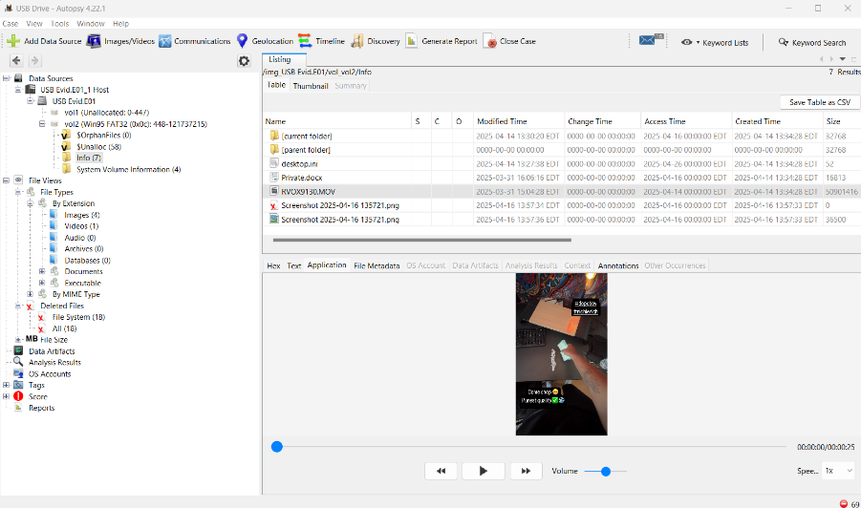
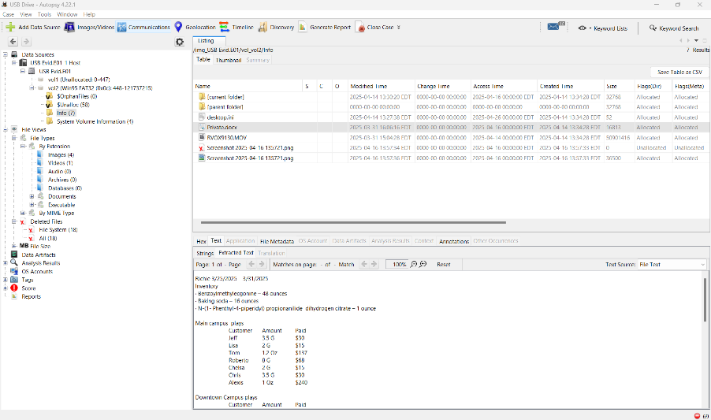
File Analysis
HOW WE FOUND THE DATA Autopsy automatically identifies deleted files by parsing through the file system metadata.
We navigated to the Deleted Files section, where the image appeared with red "x" icon. The file retained enough metadata for Autopsy to recognize its name and partial content.
We explored the file tree in Autopsy, where the hidden text file appeared in a folder structure, even though it wouldn't normally show up in the Windows File Explorer.
Autopsy listed all files regardless of its file attributes, so we were able to preview the contents of the file when we clicked on it.
WHAT THE DATA WAS The deleted photo was a standard .jpg or .png, that had been deleted and because we were able to preview the photo in Autopsy, we can infer that the photo was not corrupt and at least partial intact.
The hidden text file contained readable content and Autopsy's internal viewer displayed its contents without error then we can infer that the file was fully intact and not corrupted.
DOES AUTOPSY INDICATE CORRUPTION Yes, to an extent. If the file is corrupted then Autopsy would show garbled or incomplete content in the preview window, missing metadata, or a failure to extract or preview the file.

Slide 11

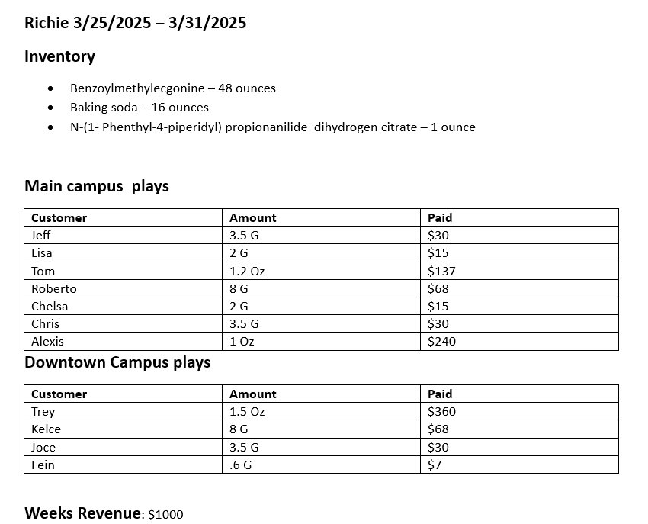
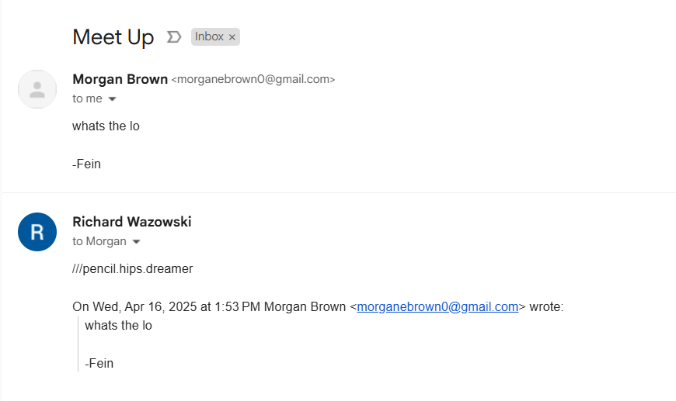
Original Data

Slide 12
Summary
Our original problem statement was to determine whether we could recover hidden and deleted files from a USB through a gray box test. In doing so, we took on two roles. The first role was that of the attacker, Richard Wazowski, who attempted to obstruct drug trafficking evidence. The second role was that of digital forensic investigators, aiming to recover admissible evidence. By fully recovering the data on the seized USB drive owned by Richard Wazowski, we validated the integrity of the device’s contents and successfully met our objectives.

Slide 13
References
“Honeywell Gard USB Threat Report 2024.” HONEYWELL GARD USB THREAT REPORT 2024, White paper, hcenews.honeywell.com/rs/093-RAU-212/images/Honeywell_Gard_USB_Threat_Report_2024.pdf?utm_click=response. Accessed 30 Apr. 2025.
“Honeywell Gard USB Threat Report 2024.” HONEYWELL GARD USB THREAT REPORT 2024, White paper, hcenews.honeywell.com/rs/093-RAU-212/images/Honeywell_Gard_USB_Threat_Report_2024.pdf?utm_click=response. Accessed 30 Apr. 2025.

